Slide 1

Reinforcement Learning: Core Concepts and Principles
Exploring the foundational algorithms, agent design paradigms, and practical applications of reinforcement learning.

Slide 2



Foundations of Reinforcement Learning: The Core Algorithms
Building mastery from the ground up—three fundamental algorithms that form the backbone of reinforcement learning
Q-Learning
SARSA
Monte Carlo Methods
Off-policy TD control algorithm that learns the optimal action-value function Q(s,a) independently of the agent's current behavior
On-policy TD control algorithm that updates Q-values based on the actions the agent actually takes, following its current policy
Episode-based learning that calculates value functions from complete returns without bootstrapping from estimates

Slide 3

Q-Learning from Scratch: How It Works
The Core Concept
Why Off-Policy Matters: The agent can explore randomly while still learning the optimal greedy policy, enabling faster convergence.
Q-Learning learns the optimal action-value function by iteratively updating with observed rewards plus the discounted maximum future Q-value. As an off-policy algorithm, it learns the optimal policy regardless of the agent's exploratory behavior.
Key Update Rule
Q(s,a) ← Q(s,a) + α [r + γ max Q(s',a') - Q(s,a)]
Where α is the learning rate, γ is the discount factor, and the max operator looks ahead to find the best future action.

Slide 4
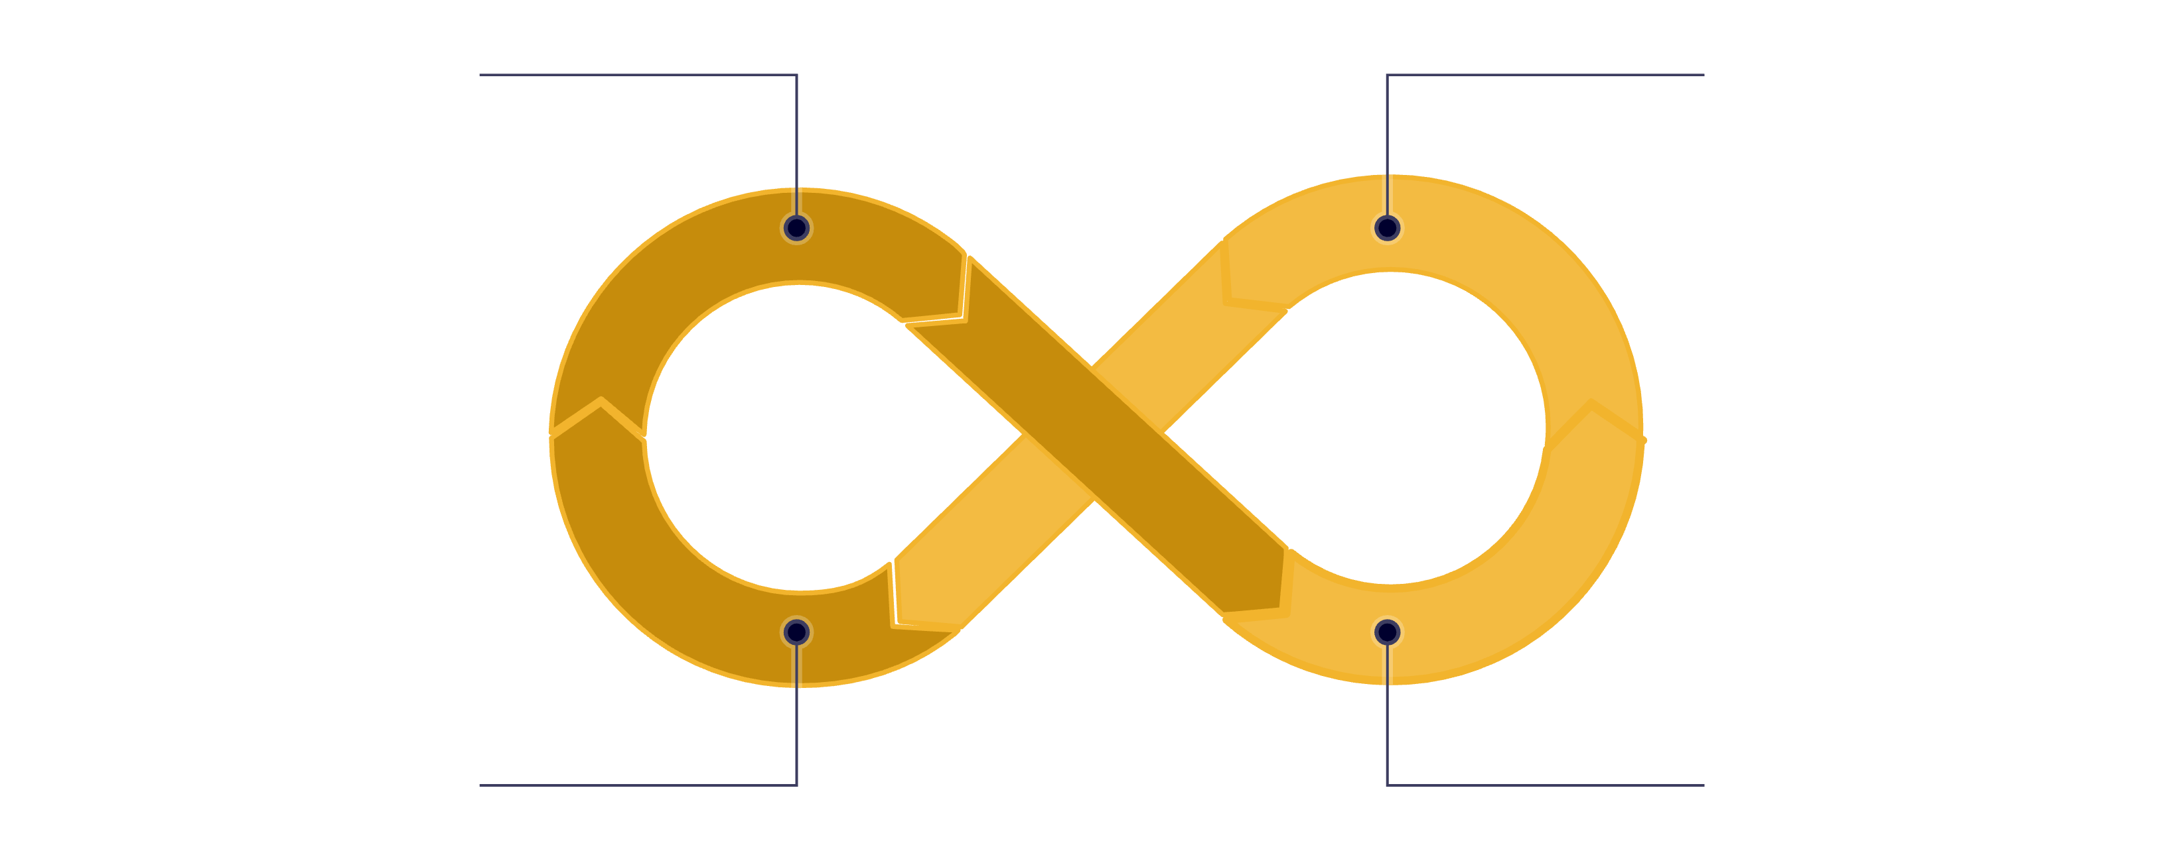
SARSA: Learning from Your Own Path
Observe State S
Select Action A
Update Q(S,A) with A'
Receive R and S'
SARSA is an "on-policy" learning method. This means it learns directly from the sequence of actions it actually takes, including any exploration. It's often used when an agent needs to be cautious and learn safe ways to explore, as it won't imagine taking a better action it didn't actually perform.

Slide 5
Monte Carlo Methods: Learning from Experience
Episode-Based Learning
Key Advantages
Monte Carlo methods wait until an episode completes, then calculate the total discounted return Gt for each state-action pair encountered. This provides unbiased estimates of value functions.
Perfect for episodic tasks where complete trajectories are available. Sample averages converge to true values given enough episodes.
Model-free and conceptually simple
No bootstrapping from estimates
Works well with function approximation
Uses actual sample returns from experience
No need for environment dynamics
Updates only after episode termination

Slide 6
Mastering CartPole: A Practical Application with OpenAI Gym
Real-world RL Playground
The Challenge
OpenAI Gym's CartPole environment provides a tangible challenge to implement and observe agent behavior, demonstrating core reinforcement learning principles.
Balance an upright pole on a moving cart. Prevent the pole from exceeding a ±15° tilt or the cart from drifting too far.
Implementation Approach
Developed Q-Learning and SARSA agents in Python.
Discretized continuous state space for tabular RL methods.
Tuned ε-greedy exploration strategies for optimal balance.
Analyzed learning curves, observing steady performance improvement.
Key Insight: Agents transformed from chaotic actions to consistent balance (>200 timesteps), illustrating effective control policy convergence.

Slide 7
Practical Step 2: Deep RL with Atari Breakout
01
02
Deep Q-Networks (DQN)
CNN Architecture
Transitioned from tabular methods to function approximation using neural networks that process raw pixel inputs directly
Leveraged convolutional neural networks with multiple layers to extract spatial features from 84×84 grayscale game frames
03
04
Experience Replay
Current Performance
Implemented replay buffer to store and sample past experiences, breaking correlation between consecutive samples
Agent performance now surpasses random play, with ongoing tuning for training stability and higher scores

Slide 8
Challenges and Insights So Far
Exploration vs Exploitation
Sample Efficiency
Finding the right balance remains critical—too much exploration wastes learning time, while too little exploitation prevents discovering better strategies. ε-decay schedules require careful tuning.
Deep RL algorithms require massive amounts of environment interactions. CartPole converged quickly, but Atari games need millions of frames, making compute resources a limiting factor.
Training Stability
Reward Engineering
Neural network training can be unstable with non-stationary targets and correlated data. Experience replay and target networks help, but hyperparameter sensitivity remains high.
Understanding environment dynamics and shaping rewards appropriately is crucial. Sparse rewards make learning difficult, while poorly shaped rewards can lead to unintended behaviors.

Slide 9



Next Steps: Building Deeper Understanding
The journey continues with more advanced algorithms and broader applications
Advanced DQN Variants
Experimenting with Double DQN to reduce overestimation bias, Dueling Networks to separate value and advantage functions, and exploring Policy Gradient methods like A3C and PPO
Multi-Task & Continual Learning
Exploring how agents can generalize learning across multiple Atari games and retain knowledge over time without catastrophic forgetting
Model-Based Approaches
Integrating world models and planning algorithms to improve sample efficiency by learning environment dynamics and planning ahead

Slide 10
Summary & Outlook
Progress Achieved
From implementing foundational algorithms from scratch to deploying Deep Q-Networks in complex Atari environments, this month has built a solid foundation in reinforcement learning principles and practice.
The Power of RL
Reinforcement learning offers transformative tools for sequential decision-making problems—from game playing to robotics, autonomous systems, and beyond.
Moving Forward
Excited to continue advancing these skills, diving deeper into cutting-edge algorithms, and contributing to real-world RL research and applications.

